Slide 1
Project Development Workflow
Using Git, GitHub, and SourceTree

Slide 2
Best Practices
origin/master should never be broken
You should always have full confidence that deploying to the remote won’t break anything
Develop features and bug fixes in side branches

Slide 3
Your View of the Project
v 3.0
v 2.0
v 1.0
initial
abc01
master
origin/master
stable

Slide 4
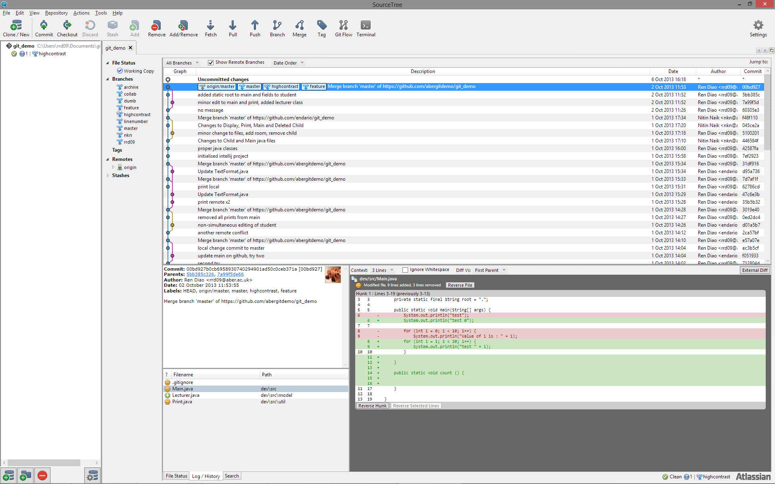
SourceTree Interface

Slide 5
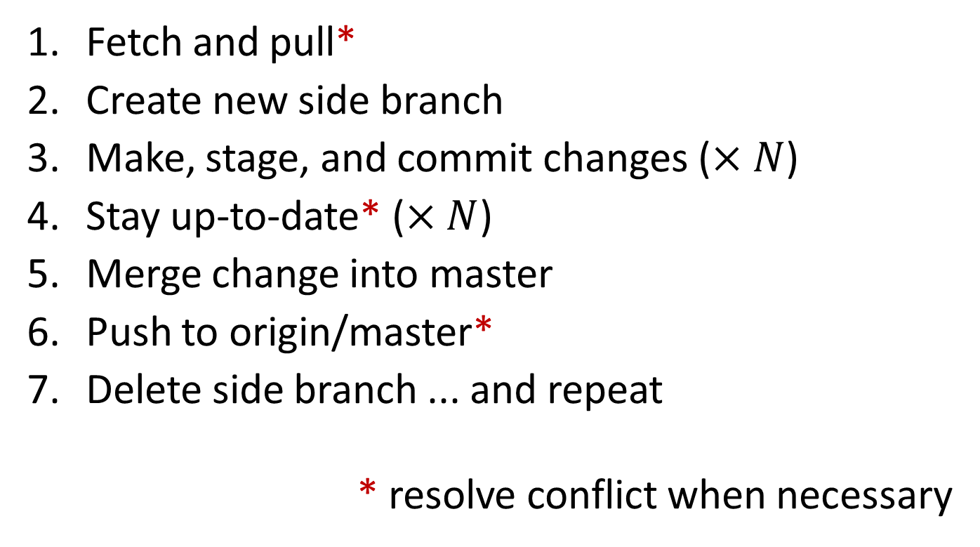
Your Daily Routine
Fetch and pull*
Create new side branch
Make, stage, and commit changes ($×N$)
Stay up-to-date* ($×N$)
Merge change into master
Push to origin/master*
Delete side branch ... and repeat
* resolve conflict when necessary

Slide 6
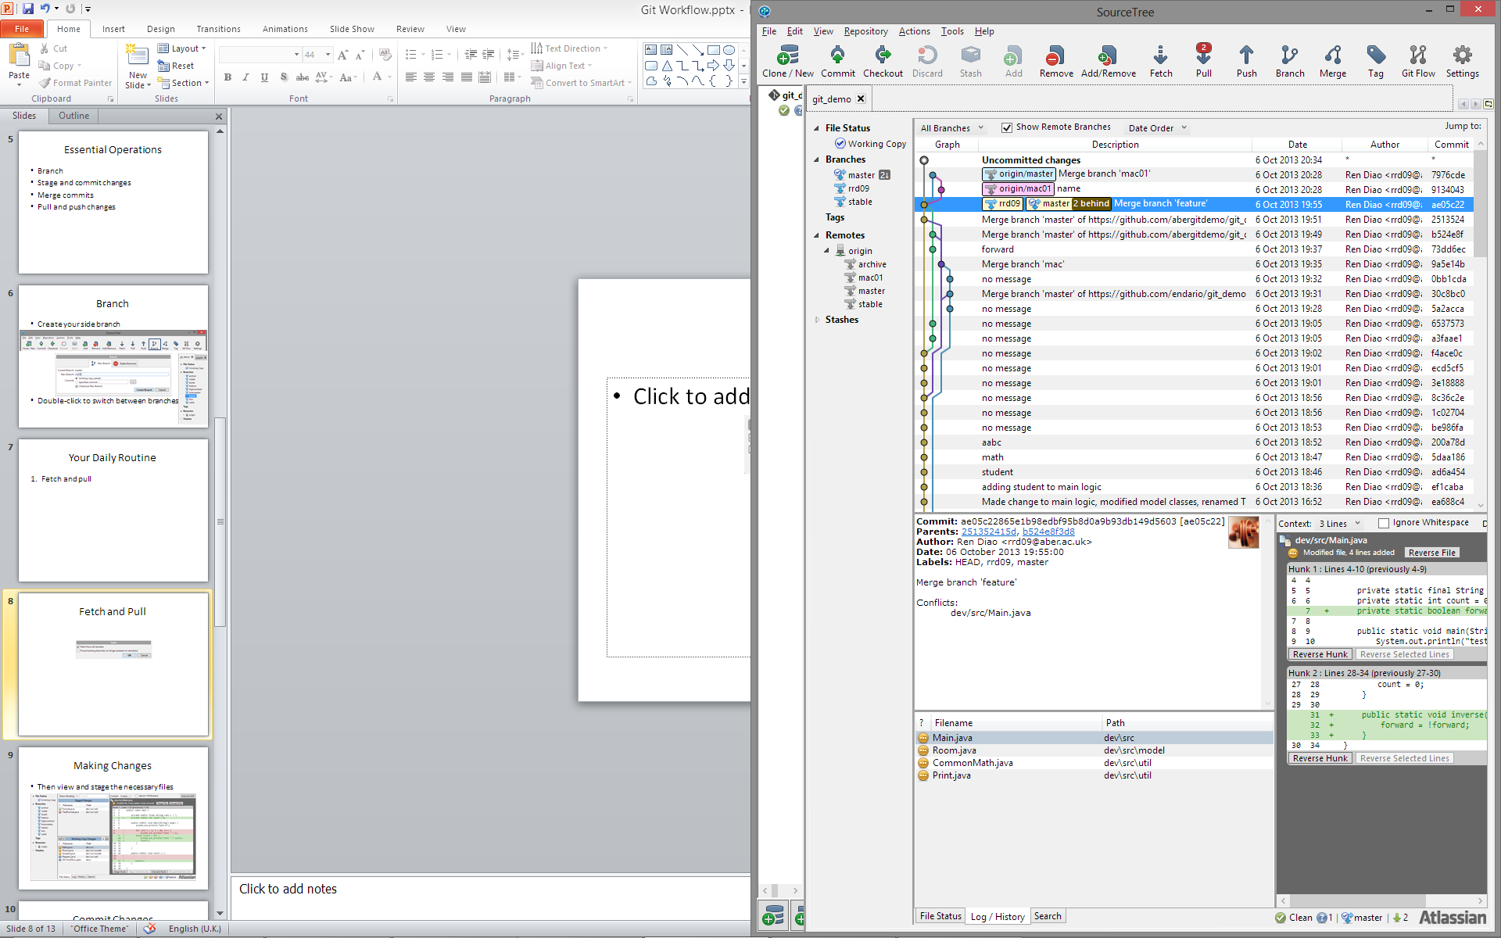
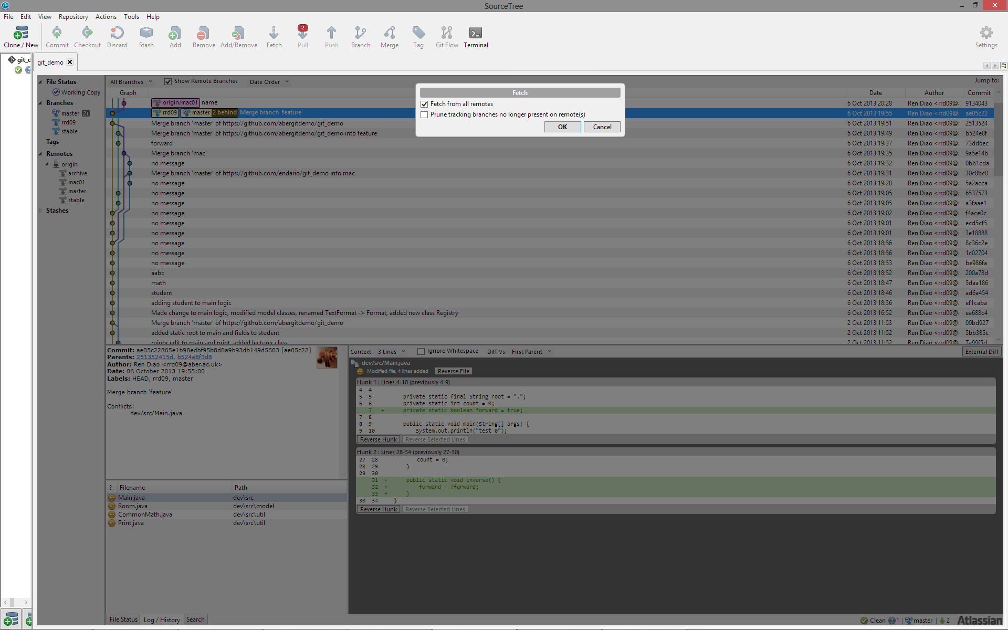
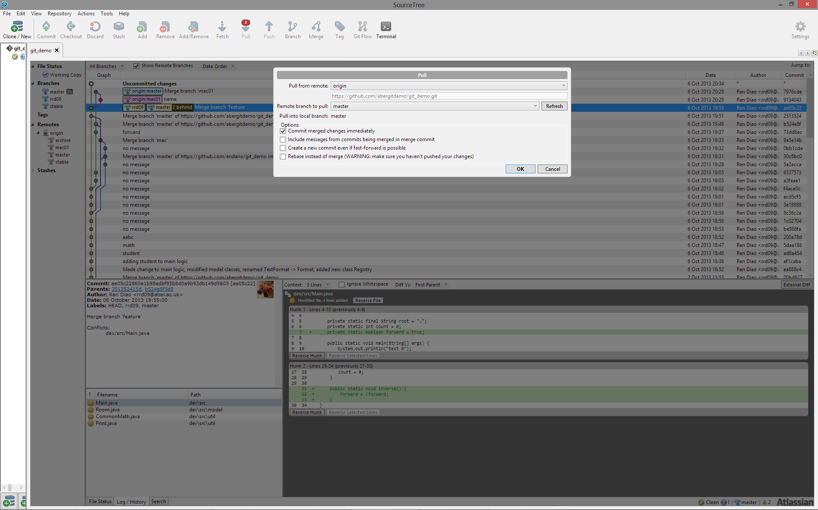
1. Fetch and Pull* (update master)
Switch to master (if not already on)

Slide 7
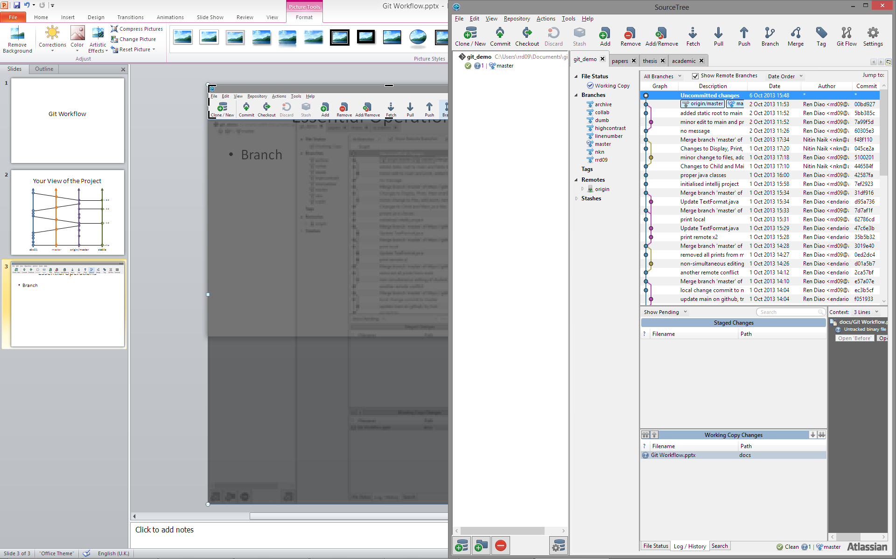
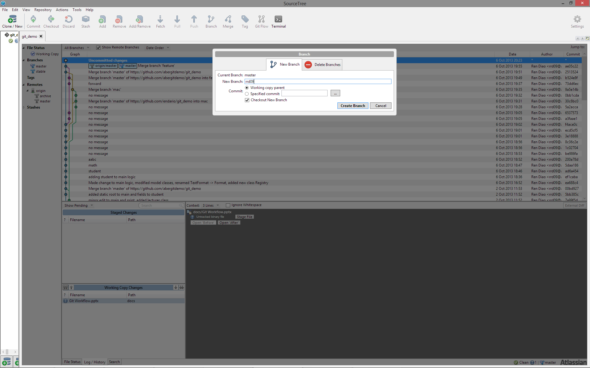
2. Create New Side Branch
Create (and switch to) a new side branch

Slide 8
3(a). Make Changes
Go nuts ...

Slide 9
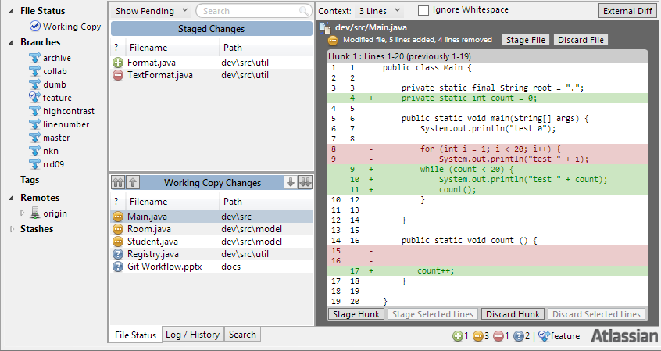
3(b). Stage Changes
Remember only stage the necessary changes

Slide 10
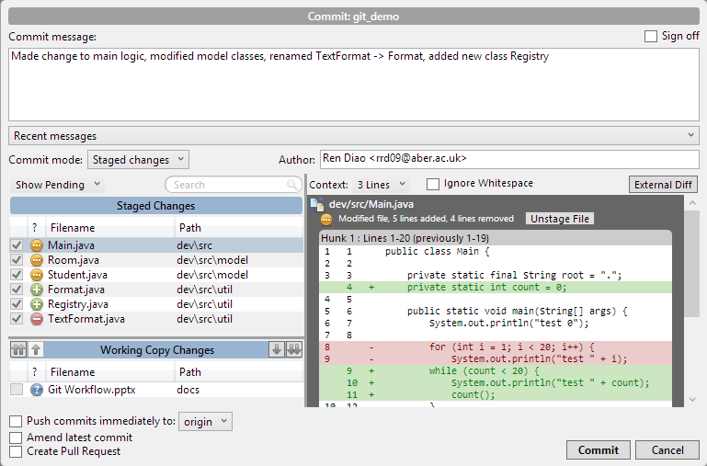
3(c).Commit Changes

Slide 11
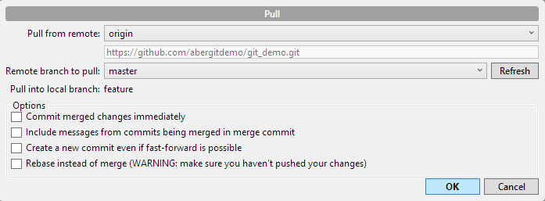
4. Keeping Up-to-Date* (while in a side branch)
Fetch & Pull origin/master into your branch
and resolve conflicts ... when necessary

Slide 12
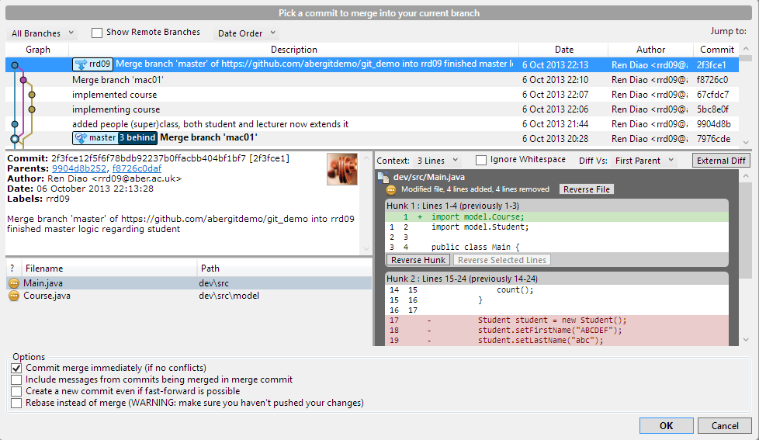
5. Merge Change into master (remember to switch to master first)
Switch to master branch

Slide 13
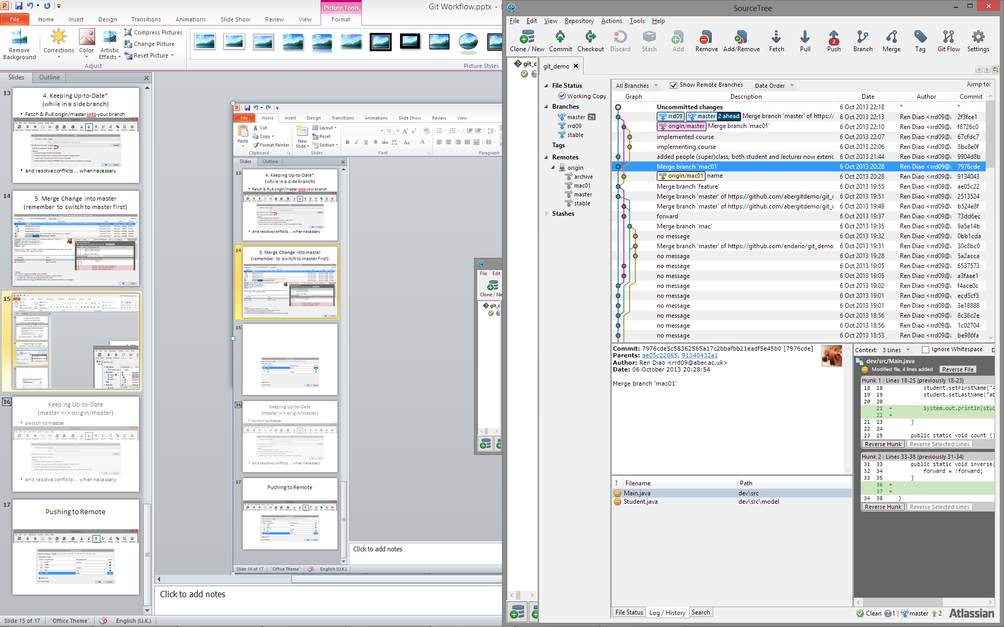
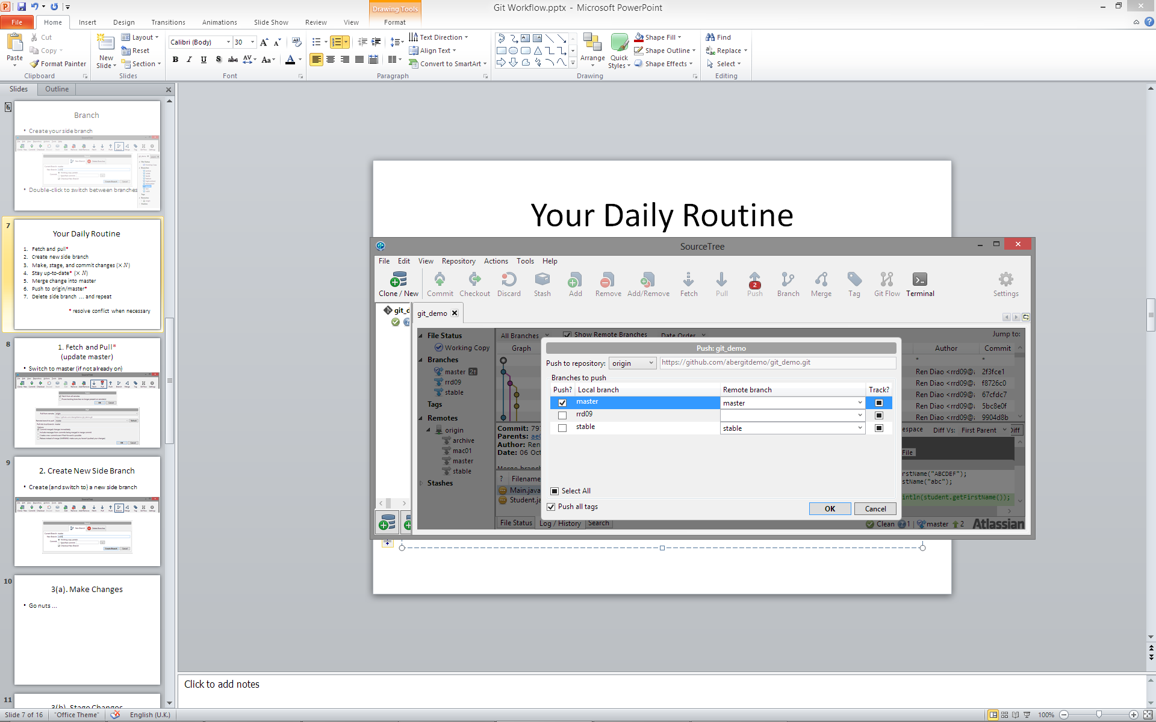
6. Push to origin/master*
If someone happens to push updates in between your steps 4 and 6, you may need to Pull again and deal with the potential merge conflicts

Slide 14
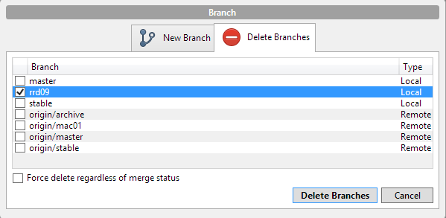
7. Delete side branch ... and repeat
Delete your local side branch if this particular line of development is completed
Rinse and repeat

Slide 15
Essential Operations
Branch
Stage and commit changes
Merge commits
Pull and push changes

Slide 16
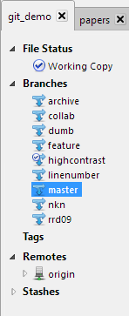
Branch
Create your side branch
Double-click to switch between branches

Slide 17
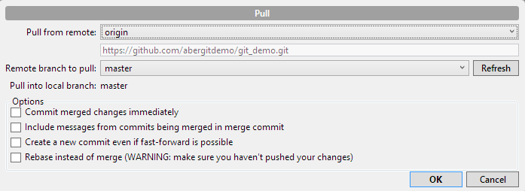
Keeping Up-to-Date (master <-> origin/master)
switch to master
and resolve conflicts ... when necessary

